Slide 1
WSN -
Leach Algorithm

Slide 2
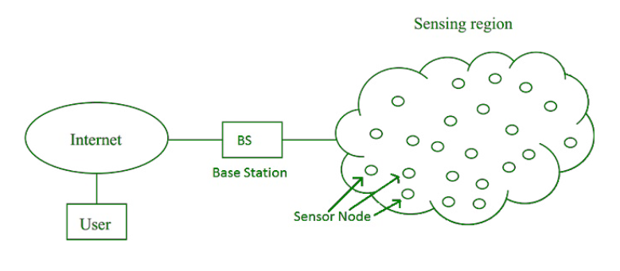
WSN - Wireless Sensor Networks
Wireless sensor networks (WSN) are a gathering of several low-power and low-cost network sensors which are used to sense an environment, collect data, process the collected data, and transmit the handled data to a base station (BS).

Slide 3
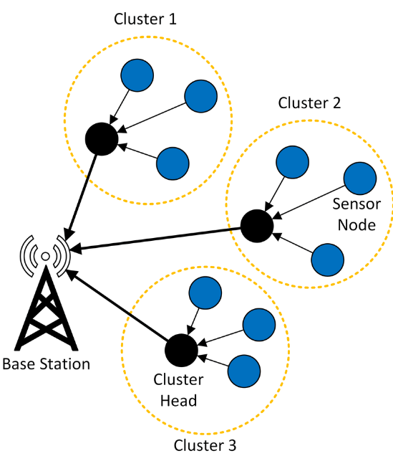
WSNs depends on several small disposable independent devices called sensor nodes to form a network. The specific nodes in WSN can sense an environment, process the sensed data, or send it to a central unit for processing through a wireless link. The daily demand for WSN keeps increasing, ranging from military use to national, ground, and space usage.
The major problems in the WSN are the large number of nodes used, their low power rating, and their restriction to short distance communication.
Researchers have widely grouped sensor nodes into clusters in direction to attain the aim of network scalability; each group has a cluster-head (CH).
There are several benefits of clustering and the greatest of it all is the implementation of an enhanced organization strategy which additionally extends the lifetime of the sensor batteries and further improves the network operation life. The other nodes in the cluster can opt to operate in low power mode saving energy etc.

Slide 4
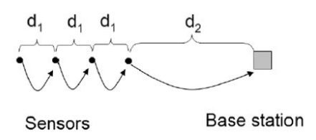
Data Collection Methods vs LEACH
Direct Transmission
Each sensor node transmits directly to the sink, regardless of distance
Most efficient when there is a small coverage area. Easy for the nodes to lose power.
Multi Hop
Data is transferred to nearby nodes and keeps traversing until it reaches the BS.
Static Clustering
Fixed CH and clusters. CH collects data from the cluster nodes. Once CH dies, that particular cluster is useless.

Slide 5
Leach vs Static clustering and advantages:
Low Energy Adaptive Clustering Hierarchy
LEACH was developed as a conservative clustering method for WSNs due to the failure of the conventional protocols to ensure an even dissipation of energy throughout a network. As such, LEACH was developed to offer a balanced energy utilization through a random CHs rotation.
Adaptive Clustering
Distributed
Randomized Rotation
Biased to balance energy loss

Slide 6
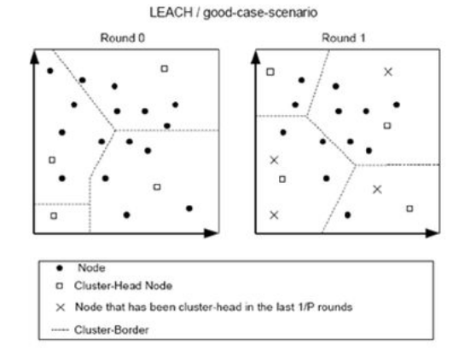
LEACH - Low Energy Adaptive Clustering Hierarchy
LEACH is dynamic because the job of the cluster head rotates. BS is fixed.
LEACH network has two phases in which it operates:
The Setup Phase : cluster heads are chosen
The Steady State : with chosen CH, the data is transmitted between nodes finally to the BS.

Slide 7
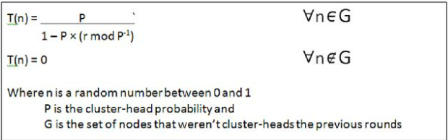
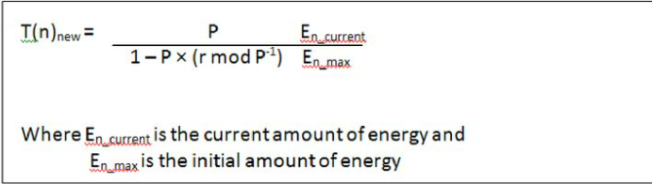
Setup Phase : Leach and Leach-C
The cluster heads are randomly chosen based on this algorithm :
If n < T(n) it becomes the CH.
The algorithm is designed such that every node becomes the CH at least once.
Another modified version is LEACH-C (centralized)
This algorithm takes into account the energy of the node when deciding on CH.

Slide 8
Disadvantages of LEACH
After completion of some rounds, the probability of sensor nodes with high energy as well as low energy becoming the CH is the same. If the sensor node with less energy is chosen as the CH, then it dies quickly
Formation of clusters in basic LEACH is random and leads to unequal distribution of clusters in the network
When the sensing area is beyond a certain distance, CHs which are far away from the BS spend more energy compared to CHs which are near to the BS

Slide 9
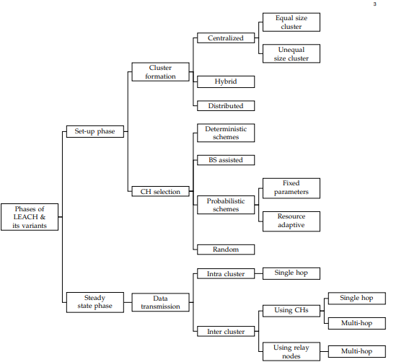
Different Phases and their variants

Slide 10
Improved Leach Protocols
LEACH-C (LEACH-Centralized) – Set up operations performed by BS, decreases overhead of sensor nodes,evenly spread clusters and CH’S
Quadrant LEACH- Divides into quadrants to form even clusters,so distance between CH’s and BS is decreased in many cases.
LEACH-H (LEACH-Hybrid)-the number of CHs are fixed for each round. The BS determines the optimal number of CHs set and forms the optimal cluster,the selection of CHs is an iterative process
LEACH-ME (LEACH-Mobile Extended)-selects CH on the basis of mobility of nodes and their attenuation power.

Slide 11
Major Parameters for proposing new protocols
Energy efficient communication in WSN.
Improvement in scalability.
Increasing the security in WSN.
Minimization of network delay.
Reduction of complexity.
Assurance of connectivity under various scenarios.
Equal load distribution over entire network.
.

Slide 12
Conclusion
Since the ultimate goal is to increase the lifespan of the nodes individually and the network as a whole, we can conclude by saying LEACH benefits us by the apt usage and rotation of nodes providing a long lifespan before the energy dies out. The LEACH-C algorithm is proven to provide 30% more lifetime until the first node dies(FND) and increases the (HND) Half node dies lifetime by 20% compared to the LEACH.

